Slide 1
Mount Auburn Professional Services
Practice Improvement Project
Primary Care Center
Improving Rate of Return of
Hemosure IFOB tests
9/25/2015

Slide 2
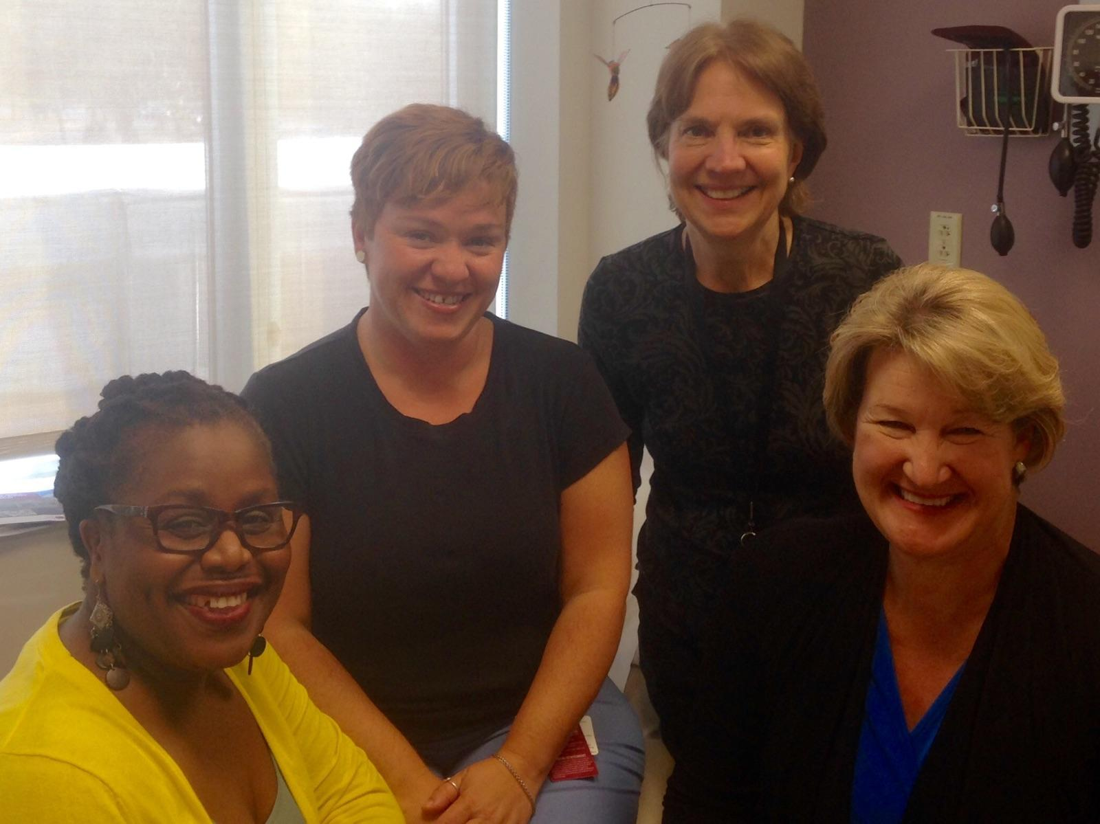
Practice Improvement Team
Dr. Linda Powers, Champion
Laura Mahoney, Project Leader
Denize Ramos, Clinical Assistant
Mirca Cayemite, Admin. Assistant

Slide 3
Background
Mt. Auburn Office Practice Improvement Project for the Primary Care Center focuses on educating patients on the need for colon cancer screening. IFOB tests are required annually for those patients who declined colonoscopies.
In this project, we seek to increase the rate of return of IFOB kits through:
  Colon cancer education, IFOB directions,
  Follow-up reminder calls at 2 week intervals, and
  Letters to encourage patients to return the kits for processing

Slide 4
Aim Statement
By 7/31/2015, increase the return rate of Hemosure IFOB tests for Dr. Powers patients from current 33% to 75%.
Baseline: 33% return rate
Target: 75% return rate

Slide 5
Model For Improvement - 3 Questions
What are we trying to accomplish?
  Improved return of rate of IFOB tests from 33% to 75% by 7/31/2015.
How will we know that a change is an improvement?
  Numerator: IFOB Kits returned.
  Denominator: Total IFOB kits dispensed
What changes can we make that will result in an improvement?
  Next Slide
Measurement

Slide 6

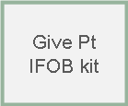
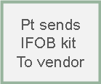
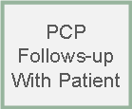
Test Ideas:
  Dispense kit to patient, make notation in EMR for huddle alert.
  Follow-up calls (2 wks) to patients who have not returned the kit
  Send letters to patients with educational information to encourage test performance and return of kit
Test Ideas fall into the first 3 boxes
Clinical A. processes specimen
To Practice

Slide 7
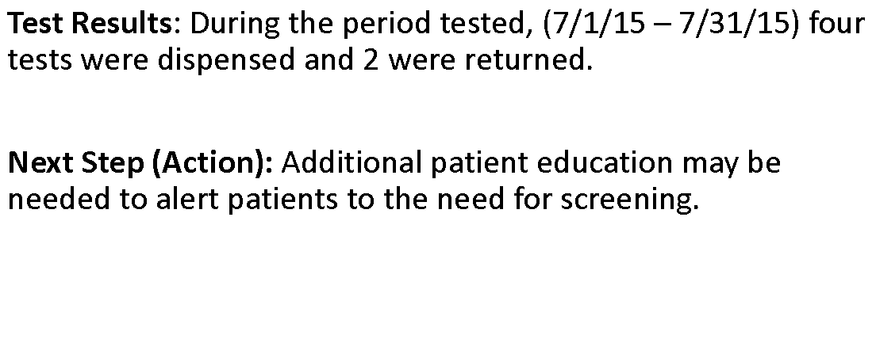
What Happened?

Slide 8
Surprises
Delay in patients returning kits
PCC has impressive response from our patients choosing colonoscopy screening versus IFOB testing

Slide 9
How will this improve Patient Safety
Increased patient education | Greater understanding of the importance of screening
Improved return ratios | Increased patient screening compliance
Meeting screening measures | Results in better scores for our practice!!

Slide 10
Next Steps
Clinical A. processes specimen
To Practice
Continue testing ideas to increase IFOB return rates
Document all steps in EMR
Complete to last box – PCP Follows-up with patient

